Slide 1
Pain and Stress in Neonates
Mangala Bharathi. S
Associate Professor of Neonatology
Institute of Child Health and Hospital for Children
Madras Medical College, Chennai
Notes:
We tend to think that newborns are too little to really experience pain, and that if they do experience it, they soon forget it. However, research has shown that, indeed, babies do experience pain — and that repeated painful experiences in the newborn period can lead to both short- and long-term problems with development, emotions, and responses to stress.

Slide 2
Objectives
Recognising Pain
  Behavioural Changes
  Physiological Changes
  Autonomic Changes
Procedures & Pain
Scales for pain evaluation
Notes:
Just because newborn babies can’t tell us they feel pain, doesn’t mean they don’t feel pain. They do. And we can help. From the day they are born, babies can feel and express pain. What are our learning objectives in this webinar? Over the years, we have learned to recognise and assess pain in babies. An assessment of pain in babies relies mostly on observing behaviours. In addition to noting behavioural changes that might indicate pain, there are physiological measures that can be used to assess pain in babies. We shall find out more about these behavioural and physiological parameters. Also, there are many established and proven objective tools available to assess pain in babies. PIPP scale is one such method and we shall learn more on it. It is important to be aware of the common procedures that cause pain in babies and the severity of pain caused.

Slide 3
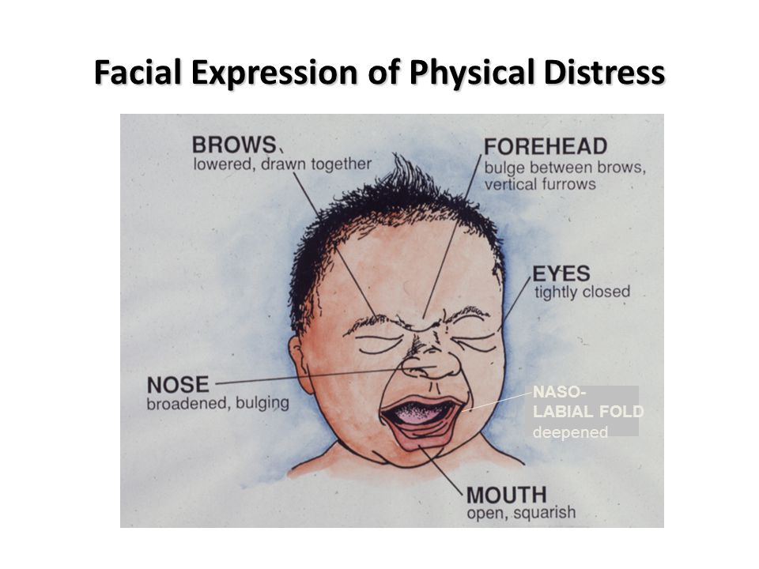
Behavioural Responses
Facial expressions
Crying
Body movements
State changes

Slide 4
Nasolabial Fold
Notes:
Bulging of the fatty pads about the infant’s eyes is pronounced

Slide 5



Body Movements
Body thrashing
Clenching of fingers

Slide 6


Body Movements
Writhing Movements
Arching of back

Slide 7
Physiological Responses
Changes in
Heart rate
Blood pressure
Respiratory rate
Saturation
Notes:
Physiological indicators like changes in heart rate, breathing rate, blood pressure, skin colour, fall in saturations are also used to determine if a baby is in pain.

Slide 8
Autonomic Changes
Mydriasis
Sweating
Pallor
Flushing
Notes:
Autonomic changes like dilated or widened pupils, sweating, vomiting, and pallor or flushing are noted in pain. Because changes in physiological and autonomic parameters can result from other causes, including physical stress, fear, or anxiety, they can be difficult to interpret. Despite these limitations, when used with behavioural indicators, physiologic and autonomic signs can be useful as part of an overall assessment for a baby in pain.

Slide 9
Painful Procedures: Mild Pain
Physical Examination
Heel Prick
Venepuncture
Arterial puncture
Im/sc injections
Feeding tube insertion
Umbilical cannulation
Adhesive tape removal

Slide 10
Painful Procedures: Moderate Pain
Lumbar puncture
Intubation
ET suction
ICD drain
Ventricular tap
Rop examination
Central line
  insertion or removal
Chest physiotherapy
Dressing change
Suprapubic puncture

Slide 11
Other conditions
Surgical procedures
NEC
Mechanical Ventilation
Meningitis
Bone and Joint Infections

Slide 12
Premature Infant Pain Profile: PIPP Scale
Facial Actions
Heart Rate Changes
Saturation Changes
State
Gestational Age

Slide 13
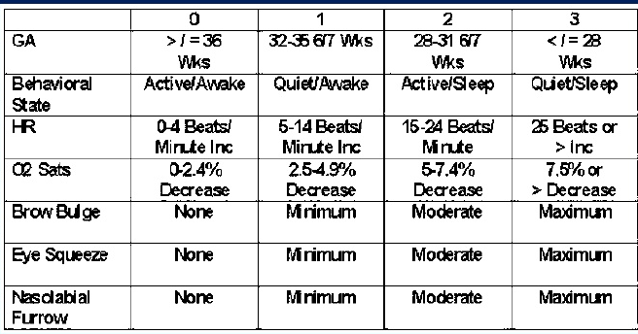

Slide 14
Thank You

